Slide 1

RAG Chatbot and Summarization Project
Developed by:
DA8115 Asli
DA8118 Burcu
DA8127 Emre
DA8121 Hasan
DA8123 Nurdan

Slide 2

Introduction
Project Purpose: Briefly describe the main goal of the project.
PDF Content: Specify the content of the PDF file used for training the model, including the topic and type of documents.
Tools & Technologies: List the key tools and technologies used in the project, highlighting their relevance to the task.
Questions & Answers: Outline the types of questions and answers that the chatbot is designed to handle.
Summarization Process: Briefly explain the summarization process employed in the project.
Results & Evaluation: Summarize the key results achieved and the evaluation methods used.

Slide 3

Purpose of the Project
Embark on a journey exploring the realm of Large Language Models, utilizing cutting-edge tools like RAG Chatbot and GPT-4o-Mini (or GEMINI) to delve into PDF analysis. Uncover insights, tackle queries, and craft concise summaries.

Slide 4

Content of the Trained PDF File
(BERT: Pre-training of Deep Bidirectional Transformers for Language Understanding)
Authors:
Conference: NAACL-HLT 2019
Date: June 2 - June 7, 2019
This research paper introduces a new language representation model called BERT (Bidirectional Encoder Representations from Transformers). The paper details two primary pre-training tasks used by BERT: the Masked Language Model (MLM) and Next Sentence Prediction (NSP). These tasks allow BERT to achieve state-of-the-art performance across a wide range of natural language processing (NLP) tasks.
This PDF document about BERT is 16 pages long. It details the BERT model, its principles, and its performance across various NLP tasks.

Slide 5
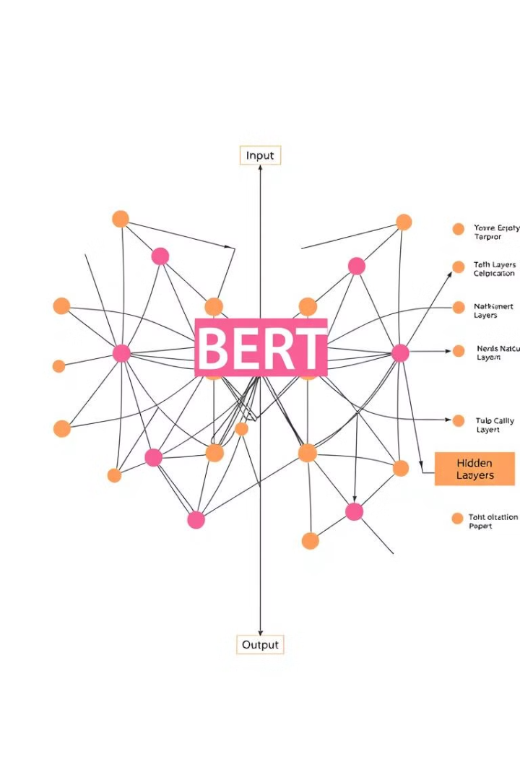
PDF Content: BERT
1
Introduction
BERT: Bidirectional Encoder Representations from Transformers, by Google AI Language.
2
Key Innovation
Considers both left and right context of words simultaneously.
3
Pre-training Tasks
Masked Language Model (MLM) and Next Sentence Prediction (NSP).
4
Results
State-of-the-art performance across various NLP tasks.

Slide 6

Key Steps
Document Analysis with LLMs: We leveraged RAG Chatbot and GPT-o-Mini to train on the PDF document. This involved parsing the text and extracting key concepts and information about PDF content.
Question-Answering: Using the trained models, we posed various questions related to the PDF content and evaluated the accuracy and relevance of the responses provided by the LLMs.
Summarization: We applied the LLMs' summarization capabilities to condense the document, highlighting the most important aspects of PDF and impact on NLP tasks.
Tools and Technologies
Project 1 = Information about Rag chatbot

Slide 7
Tools and Technologies
RAG Chatbot
GPT-4o-Mini
GEMINI
Retrieval-Augmented Generation for enhanced question-answering capabilities.
Smaller, efficient version of GPT for various NLP tasks.
Google's advanced language model for diverse applications.

Slide 8

Questions and Answers
Question
Answer
What is BERT?
Language representation model using bidirectional context.
Key components?
Multi-layer Transformer, unified architecture, special tokens.
our_query = "What is BERT?"
BERT, which stands for Bidirectional Encoder Representations from Transformers, is a language representation model that improves fine-tuning approaches for natural language processing tasks. It is designed to address the limitations of unidirectional models by using a "masked language model" (MLM) pre-training objective, allowing it to incorporate context from both directions. BERT has achieved state-of-the-art results on various tasks, including question answering and language inference, without requiring substantial modifications to task-specific architectures.
our_query = "What are the key architectural components of BERT?"
answer = get_answers(our_query)
answer

Slide 9

The Key Architectural Components of BERT
Multi-layer Bidirectional Transformer Encoder: BERT is based on a multi-layer bidirectional Transformer architecture, which allows it to consider context from both the left and right sides of a token.
Unified Architecture: There is minimal difference between the pre-trained architecture and the final downstream architecture, allowing for a consistent approach across different tasks.
Model Sizes: BERT primarily comes in two sizes:
BERTBASE: 12 layers (Transformer blocks), hidden size of 768, and 12 self-attention heads, totaling 110 million parameters.
BERTLARGE: 24 layers, hidden size of 1024, with a larger number of parameters.
Input Representation: BERT uses special tokens such as [CLS] for classification tasks and [SEP] to separate different segments of input.
Pre-training and Fine-tuning: The same architecture is used for both pre-training and fine-tuning, with all parameters being fine-tuned during the latter phase.
These components contribute to BERT's ability to effectively understand and generate language representations.

Slide 10

Project 2: Summarization Process
Gpt-o-mini and gemini kisa bilgi Chain_type
“Stuff”
chain = load_summarize_chain(
llm,
chain_type='stuff'
)
output_summary = chain.invoke(pdf_doc[0:5])['output_text']
The paper introduces BERT (Bidirectional Encoder Representations from Transformers), a novel language representation model developed by Google AI Language. Unlike previous models that use unidirectional context, BERT pre-trains deep bidirectional representations from unlabeled text, allowing it to consider both left and right context in all layers. This design enables BERT to be fine-tuned with minimal additional architecture for various natural language processing tasks, achieving state-of-the-art results on eleven benchmarks, including significant improvements in GLUE, MultiNLI, and SQuAD. BERT employs a masked language model pre-training objective, enhancing its effectiveness for both sentence-level and token-level tasks.
“Map_reduce”
chain = load_summarize_chain(llm,
chain_type="map_reduce")
output_summary = chain.invoke(chunks)["output_text"]
The paper presents BERT (Bidirectional Encoder Representations from Transformers), a groundbreaking language representation model developed by Google AI Language. Unlike previous unidirectional models, BERT utilizes deep bidirectional representations by conditioning on both left and right contexts, allowing for effective fine-tuning with minimal task-specific adjustments. It employs a masked language model (MLM) and next sentence prediction (NSP) during pre-training, significantly improving performance across eleven natural language processing (NLP) tasks, including GLUE, MultiNLI, and SQuAD benchmarks. BERT's architecture, which includes a unified multi-layer bidirectional Transformer encoder, supports versatile input representations for single and paired sentences. The model's performance is enhanced through extensive pre-training on large corpora, and it achieves state-of-the-art results, outperforming previous models in various tasks. The study also explores the impact of pre-training tasks, model sizes, and fine-tuning strategies, emphasizing the importance of rich unsupervised pre-training for effective NLP applications.
“Refine”
chain = load_summarize_chain(llm,
chain_type="refine")
output_summary = chain.invoke(chunks)["output_text"]

Slide 11
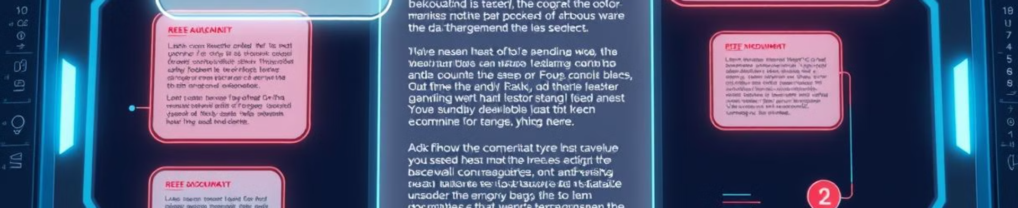



Summarization Process
Stuff
Map-Reduce
Refine
Combines all text chunks into single prompt for summarization.
Summarizes chunks individually, then combines summaries.
Iteratively refines summary by incorporating new information.

Slide 12
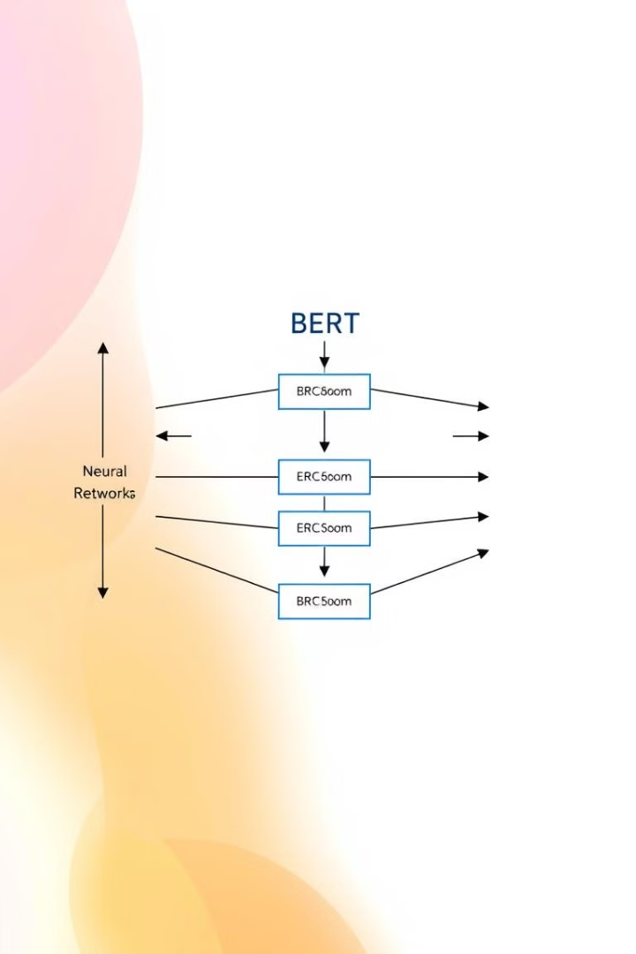
BERT Architecture
Bidirectional Transformer
Considers context from both left and right sides of tokens.
Model Sizes
BERTBASE (110M parameters) and BERTLARGE (larger version).
Input Representation
Uses special tokens [CLS] and [SEP] for classification and separation.
Pre-training and Fine-tuning
Same architecture used for both stages.

Slide 13

Final Summary
The paper introduces BERT (Bidirectional Encoder Representations from Transformers), a novel language representation model developed by Google AI Language. Unlike previous models that use unidirectional context, BERT pre-trains deep bidirectional representations from unlabeled text, allowing it to consider both left and right context in all layers. This design enables BERT to be fine-tuned with minimal additional architecture for various natural language processing tasks, achieving state-of-the-art results on eleven benchmarks, including significant improvements in GLUE, MultiNLI, and SQuAD tasks.
BERT employs a masked language model (MLM) pre-training objective, which enhances its effectiveness for both sentence-level and token-level tasks. The model randomly masks a percentage of input tokens and predicts them, allowing for a deep bidirectional representation. Additionally, BERT incorporates a "next sentence prediction" (NSP) task that trains the model to understand the relationship between sentence pairs, which is crucial for tasks like Question Answering (QA) and Natural Language Inference (NLI).
To handle a variety of downstream tasks, BERT's input representation can unambiguously represent both single sentences and pairs of sentences. It uses WordPiece embeddings with a 30,000 token vocabulary, where the first token of every sequence is a special classification token ([CLS]). The final hidden state corresponding to this token is used as the aggregate sequence representation for classification tasks. Sentence pairs are packed into a single sequence, differentiated by a special token ([SEP]) and learned embeddings indicating sentence membership. The input embeddings are the sum of token embeddings, segment embeddings, and position embeddings.

Slide 14
Results and Evaluation
Chatbot projects can be used for different purposes in various fields. Here are some examples of what chatbot projects generally do:
Customer Service: Chatbots are used to instantly answer customers' frequently asked questions, provide information about products or services, and offer customer support. This allows businesses to provide customer service 24/7 and reduces the burden on human employees.
Sales and Marketing: Chatbots can direct potential customers by offering product recommendations and guiding them through the sales process. They can also be used to personalize users' shopping experiences.
Information and Education: Educational institutions or tutorial platforms can use chatbots to provide information, conduct exams, or answer students' questions about courses. Likewise, they can be used for informational purposes in other areas, such as the healthcare industry.
Reservations and Appointments: Chatbots can be used to make reservations at hotels, restaurants, or doctor's appointments. Users can select available times and make reservations by interacting with bots.
Content Recommendations: In the media and entertainment industry, chatbots recommend movies, music, books, etc. according to users' interests. can offer content suggestions.
Automating Workflow: In-house chatbots can speed up business processes by automating employees' routine tasks. For example, preparing reports, obtaining information or starting certain tasks.
Personal Assistant: Chatbots used as personal assistants can manage daily tasks, set reminders, organize a calendar, and help users plan their days.
Data Collection and Analysis: Chatbots can collect data by interacting with users and help businesses improve their strategies by analyzing this data.

Slide 15




Results and Evaluation
State-of-the-Art Performance
Improved Accuracy
Versatile Applications
BERT outperforms previous models on various NLP benchmarks.
Significant improvements in GLUE, MultiNLI, and SQuAD tasks.
Effective for both sentence-level and token-level tasks.

Slide 16
THANK YOU FOR LISTENING US

